Slide 1


Mansoura University Faculty of Computers and Information First Semester- 2020-2021
Computer Graphics
Grade: 2nd Year (General –BIO)
Course Instructors :
Assoc. Prof. Dr-Haitham El-Ghareeb
Dr-Ibrahim El-Hassanoni waleed mohamed

Slide 2
Chapter 10 Three Dimensional Basics

Slide 3
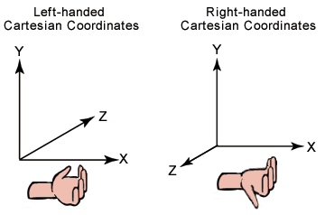
Coordinate system
two types of Cartesian coordinate systems:
left-handed
right-handed.
In both coordinate systems,
the positive x-axis points to the right,
and the positive y-axis points up.
You can remember which direction the positive z-axis points by pointing the fingers of either your left or right hand in the positive x direction and curling them into the positive y direction. The direction your thumb points, either toward or away from you, is the direction that the positive z-axis points for that coordinate system. The following illustration shows these two coordinate systems.

Slide 4
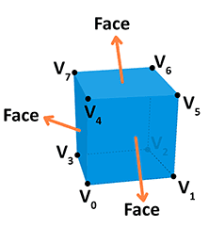
Objects
A Vertex is a point in space having its own 3D position in the coordinate system
Position: Identifies it in a 3D space (x, y, z).
Color: Holds an RGBA value (R, G and B for the red, green, and blue channels, alpha for transparency — all values range from 0.0 to 1.0).
Normal: A way to describe the direction the vertex is facing.
Texture: A 2D image that the vertex can use to decorate the surface it is part of instead of a simple color.

Slide 5
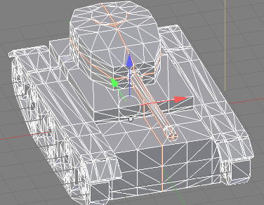
Mesh
A mesh is a collection of vertices, edges, and faces that define the shape of a 3D object. The most popular type of polygon mesh used in computer graphics is a Triangle Mesh. Any object, either a mountain or a game character, can be modelled with Triangle meshes.

Slide 6
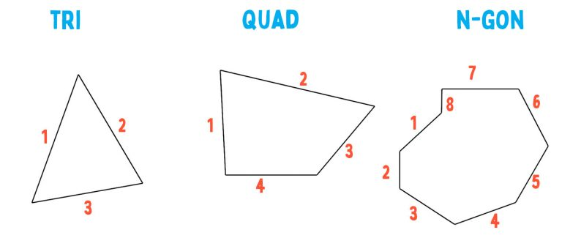
Faces: Triangle, Quad, N-Gon
A face can have a minimum of 3 vertices. This is then a triangle. If you have four vertices it is called a quad, and if you have more than four vertices, then it is simply a general polygon.
When you have 5 or more edges around a face, it’s referred to as an N-gon.

Slide 7
Normals
There are two types of normal:
Face normals
vertex normals.

Slide 8
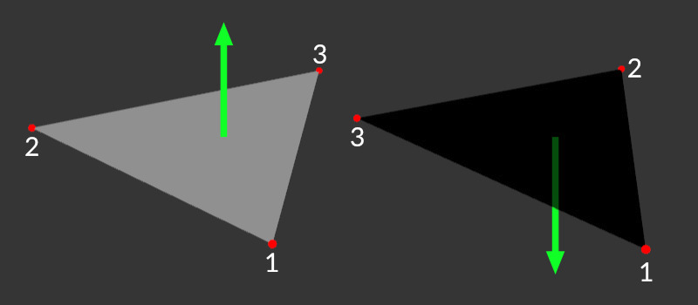
Face normals
A normal is just a hidden vector, basically a direction without a specified origin.
If the vertex order is clockwise, the normal points upwards;
if it is counter-clockwise it's pointing down.

Slide 9
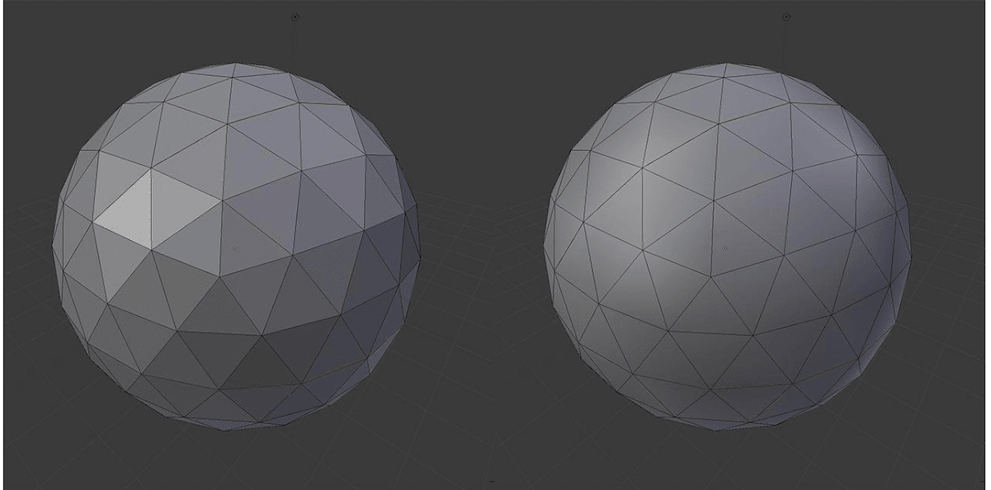
Vertex Normal
Those 2 models consist of the same vertex positions,
yet look totally different when rendered. How is that possible?
we can also give it a hint on how the surface is sloping يميلin that exact position.
The hint is in the form of the normal of the surface at that specific point on the model.

Slide 10
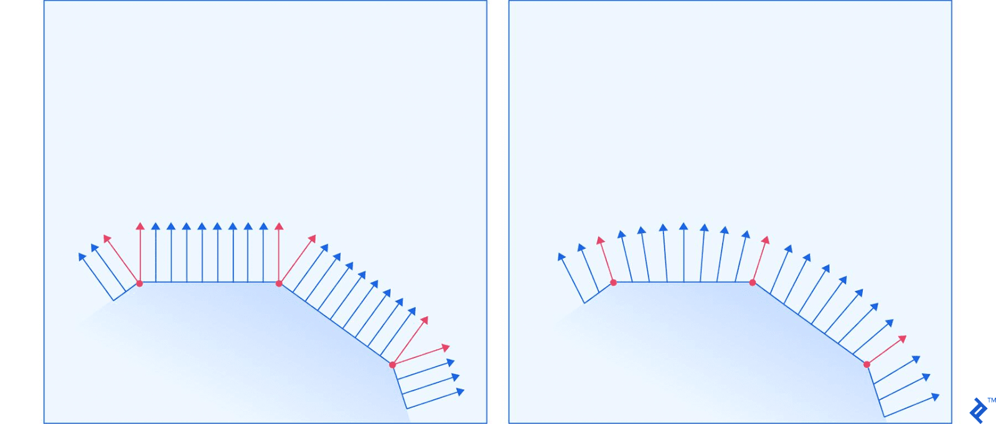
Vertex Normal-2
The left and right surface correspond to the left and right ball in the previous image, respectively.
The red arrows represent normals that are specified for a vertex, while the blue arrows represent the renderer’s calculations of how the normal should look for all the points between the vertices.

Slide 11
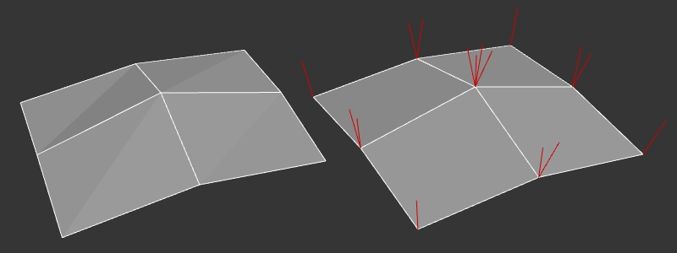
Vertex Normal-3
In the case of a single triangle, all the vertex normals point in the same direction as the face normal - unless explicitly changed by the artist/designer. This is not particularly useful for a single triangle but it gets interesting if we have neighboring polygons.
vertex normals in a multi-polygon mesh

Slide 12
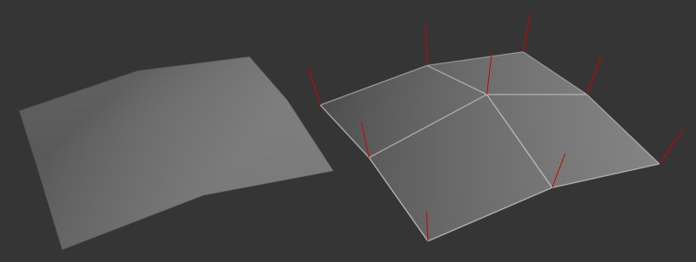
Smoothing normal-p1
We can average multiple normals together to make the surface look smooth and much more detailed than it actually is. Now, several faces share the same vertex normal which is used to calculate the shading on the surface.
vertex normals in a smoothed mesh

Slide 13
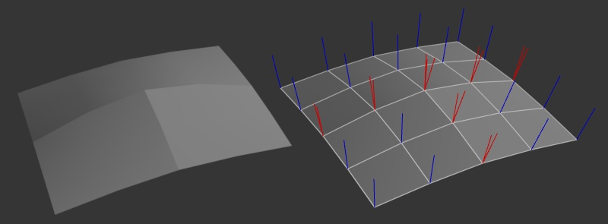
Smoothing normal-p2
Or another way, we define 3 smooth areas with hard edges between them. You can see on the right that the vertices on those edges still have some of their vertex normals diverging from another.
smoothing groups

Slide 14
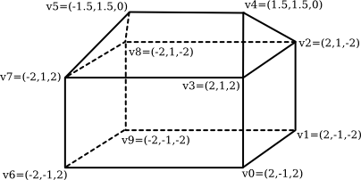
Indexed Face Sets
The vertex list for this polyhedron has the form
Vertex #0. (2, -1, 2)
Vertex #1. (2, -1, -2)
Vertex #2. (2, 1, -2)
Vertex #3. (2, 1, 2)
Vertex #4. (1.5, 1.5, 0)
Vertex #5. (-1.5, 1.5, 0)
Vertex #6. (-2, -1, 2)
Vertex #7. (-2, 1, 2)
Vertex #8. (-2, 1, -2)
Vertex #9. (-2, -1, -2)

Slide 15
Indexed Face Sets-p2
To describe one of the polygonal faces of a mesh, we just have to list its vertices
Face #0: (0, 1, 2, 3)
Face #1: (3, 2, 4)
Face #2: (7, 3, 4, 5)
Face #3: (2, 8, 5, 4)
Face #4: (5, 8, 7)
Face #5: (0, 3, 7, 6)
Face #6: (0, 6, 9, 1)
Face #7: (2, 1, 9, 8)
Face #8: (6, 7, 8, 9)
The vertex list for this polyhedron has the form
Vertex #0. (2, -1, 2)
Vertex #1. (2, -1, -2)
Vertex #2. (2, 1, -2)
Vertex #3. (2, 1, 2)
Vertex #4. (1.5, 1.5, 0)
Vertex #5. (-1.5, 1.5, 0)
Vertex #6. (-2, -1, 2)
Vertex #7. (-2, 1, 2)
Vertex #8. (-2, 1, -2)
Vertex #9. (-2, -1, -2)

Slide 16
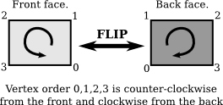
Back face
It turns out that it is often convenient to consider one of those faces to be the "front face" of the polygon and one to be the "back face." For a polyhedron like the house, the front face is the one that faces the outside of the polyhedron. The usual rule is that the vertices of a polygon should be listed in counter-clockwise order when looking at the front face of the polygon.

Slide 17
3D file formats
The basic purpose of a 3D file format is to store information about 3D models as plain text or binary data. In particular, they encode the 3D model’s geometry, appearance, scene, and animations. There are a lot of 3d formats like (fbx, 3ds, blend, obj, …).
FBX is one of the most used 3d formats.

Slide 18
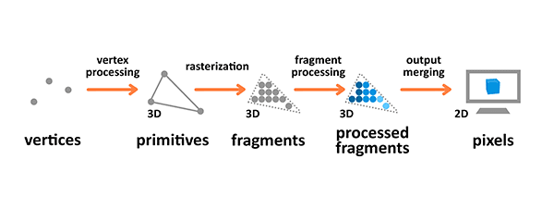
Rendering pipeline
The rendering pipeline is the process by which images are prepared and output onto the screen. The graphics rendering pipeline takes the 3D objects built from primitives described using vertices, applies processing, calculates the fragments and renders them on the 2D screen as pixels.

Slide 19
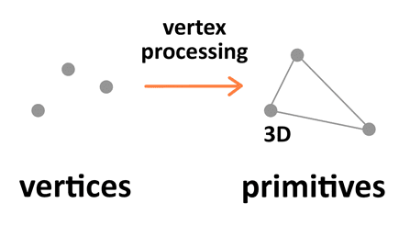
Terminology
Terminology used in the previous diagram is as follows:
A Primitive: An input to the pipeline — it's built from vertices and can be a triangle, point or line.
A Fragment: A 3D projection of a pixel, which has all the same attributes as a pixel.
A Pixel: A point on the screen arranged in the 2D grid, which holds an RGBA (Red-Green-Blue- Alpha (Transparency)) color.

Slide 20
Vertex processing
Vertex processing is about combining the information about individual vertices into primitives and setting their coordinates in the 3D space for the viewer to see. It's like taking a photo of the given scenery you have prepared — you have to place the objects first, configure the camera, and then take the shot.

Slide 21
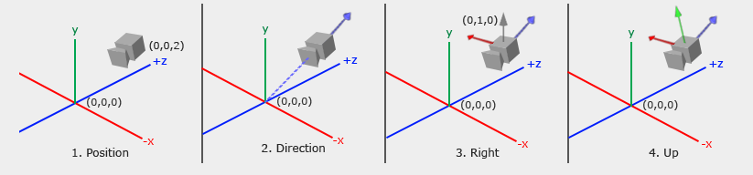
Vertex processing steps
4 steps:
Model transformation:the first one involves arranging the objects in the world.
view transformation which takes care of positioning and setting the orientation of the camera in the 3D space. The camera has three parameters — location, direction, and orientation — which have to be defined for the newly created scene.

Slide 22
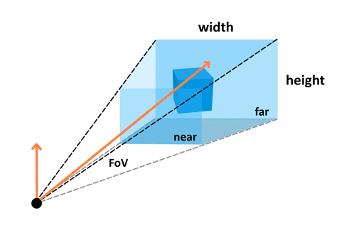
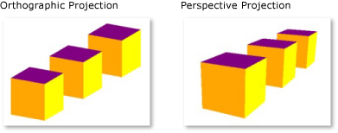
Vertex processing steps-continue
Projection transformation: then defines the camera settings. It sets up what can be seen by the camera. It contains 2 types: perspective and orthographic.
Perspective View: the configuration includes field of view, aspect ratio and optional near and far planes.
A perspective camera is how we see the real world. If we take a look at the things around us, they have depth and we can judge their distance. Imagine looking at a very long road. It will appear to get narrower as it goes further into the distance. This is due to perspective.
Orthographic view: Objects are drawn without perspective distortion.
The last step is viewport transformation, which involves outputting everything for the next step in the rendering pipeline.

Slide 23
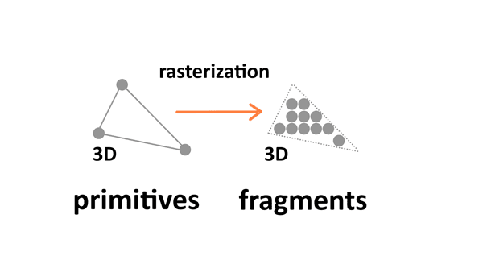
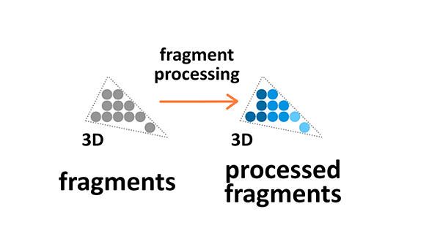
Rasterization
Rasterization converts primitives (which are connected vertices) to a set of fragments.
Those fragments — which are 3D projections of the 2D pixels — are aligned to the pixel grid, so eventually they can be printed out as pixels on a 2D screen display during the output merging stage.
Fragment processing
Fragment processing focuses on textures and lighting — it calculates final colors based on the given parameters.

Slide 24
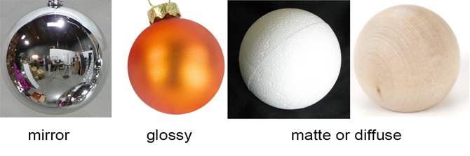
Textures
Textures are 2D images used in the 3D space to make the objects look better and more realistic. Textures are combined from single texture elements called texels the same way picture elements are combined from pixels. Applying textures onto objects during the fragment processing stage of the rendering pipeline allows us to adjust it by wrapping and filtering it if necessary.

Slide 25
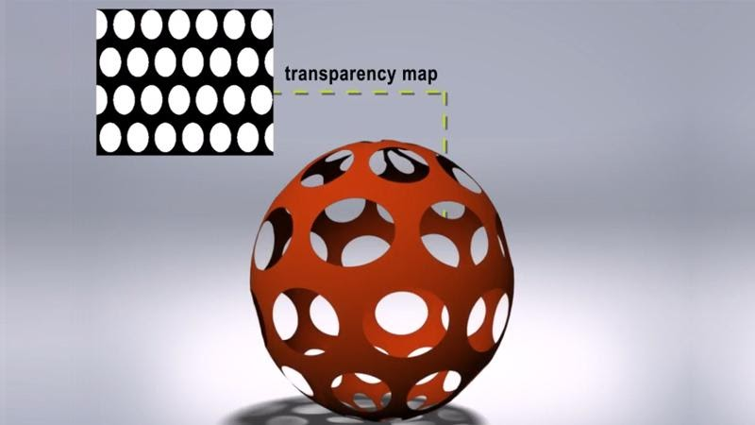
Types of texture Maps-p1
Color map, diffuse map, or Albedo map: Gives the object colours, or an appearance that you are aiming for.
Metalness map: Tells you the metallic properties of the material. Materials are either dielectric or conductive (non-metals and metals).
Roughness map or gloss map: Tells you the glossiness of the surface, determines how reflective the material is.
Transparency Map: grey scale textures that use black and white values to signify areas of transparency or opacity on an object's material

Slide 26
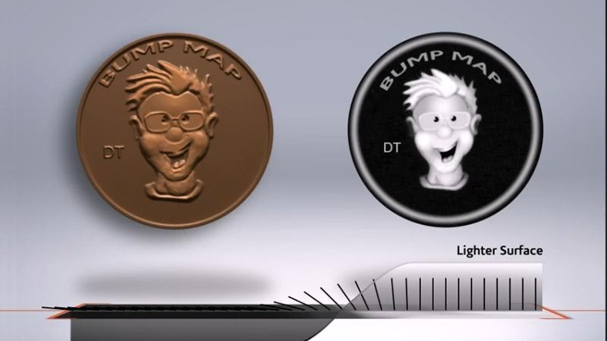
Types of texture Maps-p2
Bump map: Creates the illusion of depth by faking اصطناع بدون تغيير فعلي details on the surface using height information to tell when a point should be up or down. The surface however is still flat and not actually warped.

Slide 27
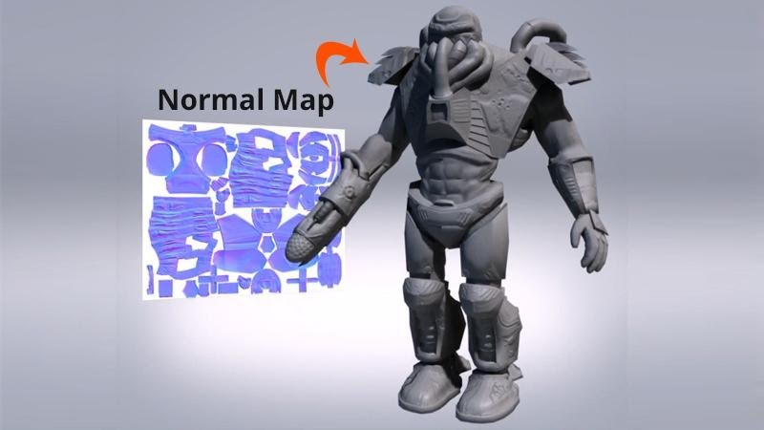
Types of texture Maps-p3
6- Normal map: A type of bump map that fakes the details by using angle information to tell which direction each point of the surface should be oriented towards. This gives better effect with lighting and shadows.

Slide 28
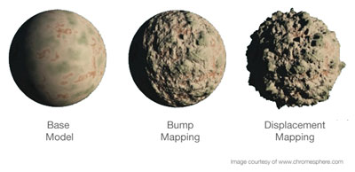
Types of texture Maps-p4
7- Displacement map: Similar to a height map but actually changes the geometry of the object by moving vertices (points) on the mesh (surface). This physically alters the form of the object.

Slide 29
Normal Maps VS. Bump Maps
both affect the normals of your geometry and create the illusion of detail without having to rely on extra geometry
bump maps just encode height information using black and white values
Black: minimum height delta
White: maximum height delta
normal maps use RGB values to signify the orientation of the surface normals:
red, green and blue channels = X, Y and Z orientation of the surface
Normal maps can typically get more detailed information onto the surface

Slide 30
Texture Coordinates (UV mapping)
commonly referred to as UV mapping. You have a model, and a texture that you want to apply to it. The texture has various areas on it, representing images that we want to apply to different parts of the model. There has to be a way to mark which triangle should be represented with which part of the texture. That’s where texture mapping comes in.

Slide 31
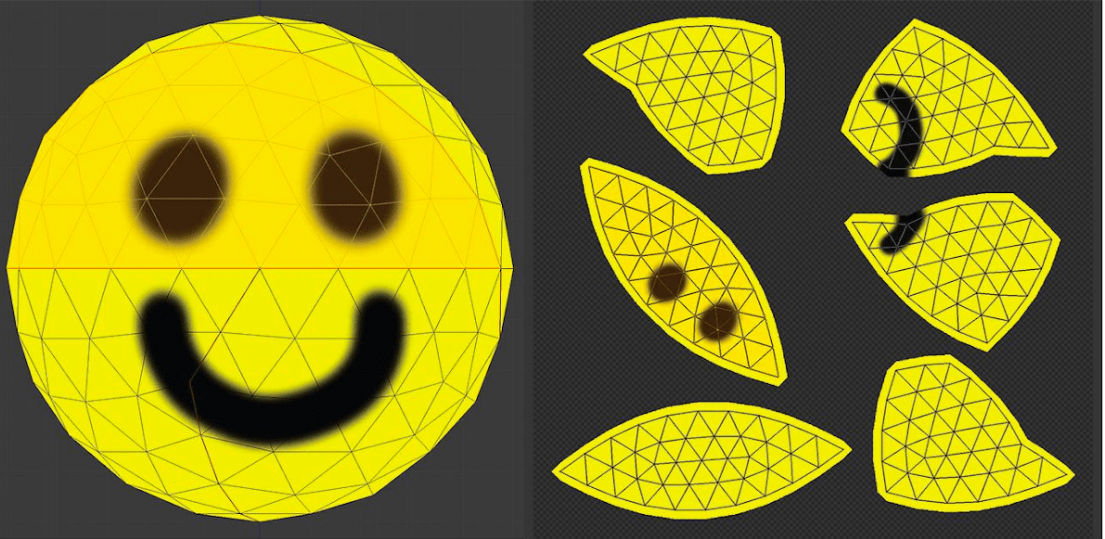
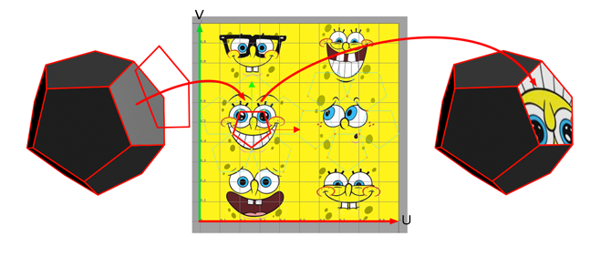
UV-mapping
For each vertex, we mark two coordinates, U and V. These coordinates represent a position on the texture, with U representing the horizontal axis, and V the vertical axis. The values aren’t in pixels, but a percentage position within the image. The bottom-left corner of the image is represented with two zeros, while the top-right is represented with two ones.
A triangle is just painted by taking the UV coordinates of each vertex in the triangle, and applying the image that is captured between those coordinates on the texture.

Slide 32
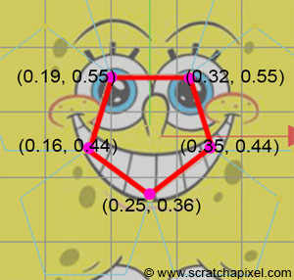
UV-mapping--example
Note : U and V values range from 0 to 1

Slide 33
Light
There are four common basic types of lighting:
Diffuse: A distant directional light, like the sun.
Specular: A point of light, just like a light bulb in a room or a flash light.
Ambient: The constant light applied to everything on the scene.
Emissive: The light emitted directly by the object.

Slide 34
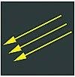
light sources
1- Directional Light
Directional lights are most often used to simulate sunlight and moonlight. Typically functioning as a key light in a scene, they provide controllable and predictable illumination. Due to the fact that the sun is so far away from the earth, by the time the light reaches us, the rays are essentially parallel to one another . That is why you will also hear the term parallel light when referring to directional lights.

Slide 35

light sources
2- Ambient light: is light that is spread everywhere equally in all directions without dissipating with distance. Although no true ambient light exists in the real world, its general purpose in 3D is to simulate the bounced light that occurs all around us. Essentially

Slide 36
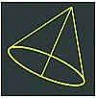
light sources
3- Spotlights:
One of the most commonly used lights in 3D is a spotlight because of the amount of control the artist has over its parameters and variety of effects. Spotlights are often the key light in a scene as well.

Slide 37
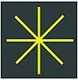
light sources
4- Point or Omni Lights: Just like it sounds, a point light emits from a single point in all directions. Also referred to as a uniform light, it is ideal for lightbulbs, lamps, candles, and the like. Point lights often are used for small areas like rooms.

Slide 38
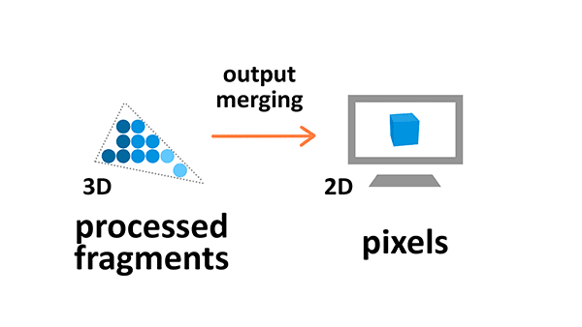
Output merging
During the output manipulation stage all the fragments of the primitives from the 3D space are transformed into a 2D grid of pixels that are then printed out on the screen display.

Slide 39
Framebuffer
The destination of a rendering pipeline is a Framebuffer.
A framebuffer contains several attachments such as Color and Depth.
However, a framebuffer can display the rendering content to a screen ONLY if a 2D array memory has been allocated and attached to a framebuffer attachment.
A 2D array memory is known as a Texture image.

Slide 40
Light and texture baking
Baking is a term that is used widely in the 3D community. It is a term that can be applied to many different processes. What it generally means is, freezing and recording the result of a computer process. It is used in everything from animations, to simulations, to texturing 3d models and much more.
There are 2 kinds of lights that can be used for games: Static and Dynamic. Dynamic lights interactively respond to the 3D scene, like shifting shadows and informing the materials they touch. Static lights are stationary and can be excluded from dynamic calculation to save game resources

Slide 41
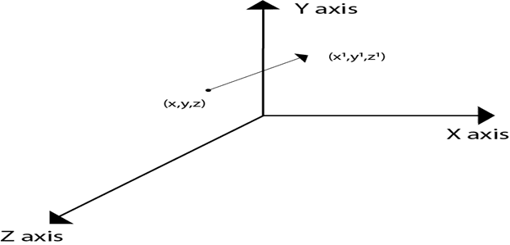
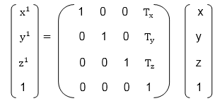
Three Dimensional Transformations
1- Translation:
is represented using T_{z}.
If P is a point having co-ordinates in three directions (x, y, z) is translated, then after translation its coordinates will be (x¹ y¹ z¹) after translation. T_{x} T_{y} T_{z} are translation vectors in x, y, and z directions respectively.
x¹=x+ T_{x} y¹=y+T_{y} z¹=z+ T_{z}

Slide 42
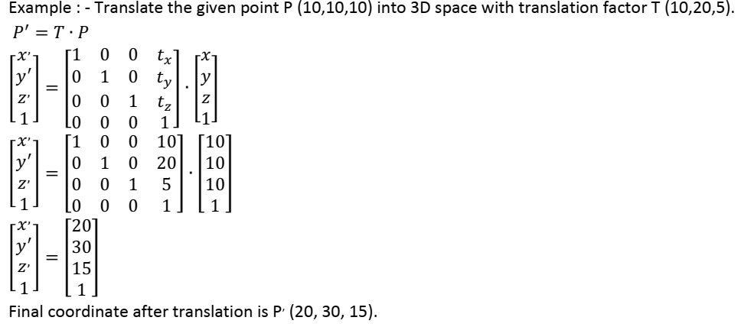
Example

Slide 43
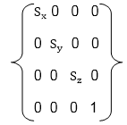
2-Scaling
Scaling is used to change the size of an object. The size can be increased or decreased. The scaling three factors are required S_{x} S_{y} and S_{z}.
S_{x}=Scaling factor in x- direction S_{y}=Scaling factor in y-direction S_{z}=Scaling factor in z-direction

Slide 44
Scaling of the object relative to a fixed point
Following are steps performed when scaling of objects with fixed point (a, b, c). It can be represented as below:
Translate fixed point to the origin
Scale the object relative to the origin
Translate object back to its original position.

Slide 45
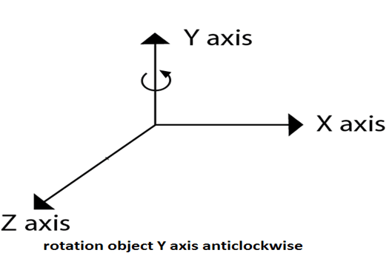
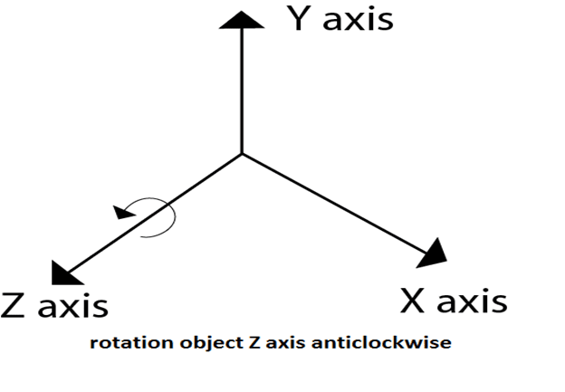
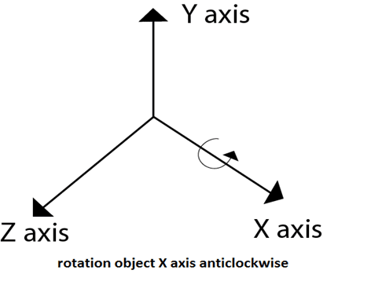
3-Rotation
It is moving of an object about an angle. Movement can be anticlockwise or clockwise. 3D rotation is complex as compared to the 2D rotation. For 2D we describe the angle of rotation, but for a 3D angle of rotation and axis of rotation are required. The axis can be either x or y or z.

Slide 46
Rotation about Arbitrary Axis
When the object is rotated about an axis that is not parallel to any one of co-ordinate axis, i.e., x, y, z. Then additional transformations are required. First of all, alignment is needed, and then the object is being back to the original position. Following steps are required
Translate the object to the origin
Rotate object so that axis of object coincide with any of coordinate axis.
Perform rotation about co-ordinate axis with whom coinciding is done.
Apply inverse rotation to bring rotation back to the original position.

Slide 47
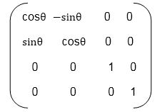
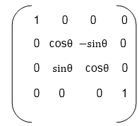
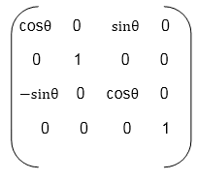
Rotation Matrices
Z axis rotation
X axis rotation
Y axis rotation

Slide 48
3D Modelling Techniques
3D models can be created in many different ways. The choice of modelling technique depends on the requirements and the complexity of the object. The following list describes some of popular 3D modelling techniques

Slide 49
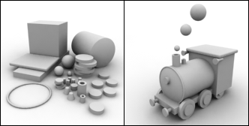
1- Standard Primitives and Modifiers
By combining several different standard objects and by modifying them, one can create complex 3D models.

Slide 50
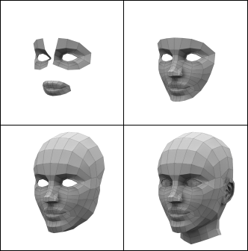
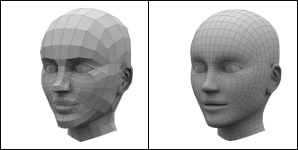
2-Polygon Modelling
Complex objects are often modeled polygon by polygon. 3D software packages include many efficient tools for creating and manipulating polygons.
Subdivision surface means a surface which is created by dividing the original 3D model into smaller polygons.

Slide 51
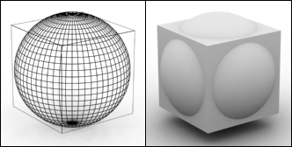
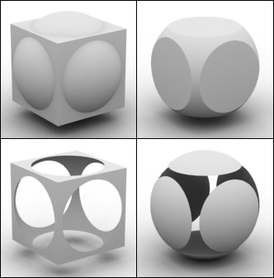
3-Boolean Operations
Union: Two 3D models are combined and the unnecessary geometry inside of the Models is removed.
Intersection: Overlapping a part of the two 3D objects.
Subtraction (A-B): Object A is subtracted from object B.
Subtraction (B-A): Object B is subtracted from object A.

Slide 52
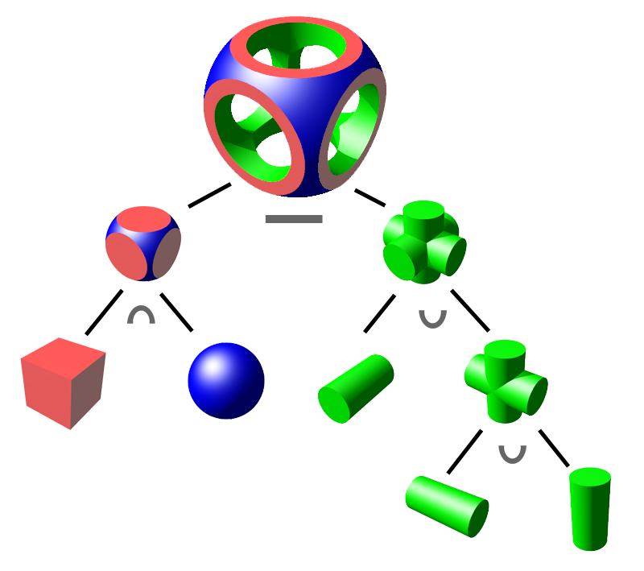
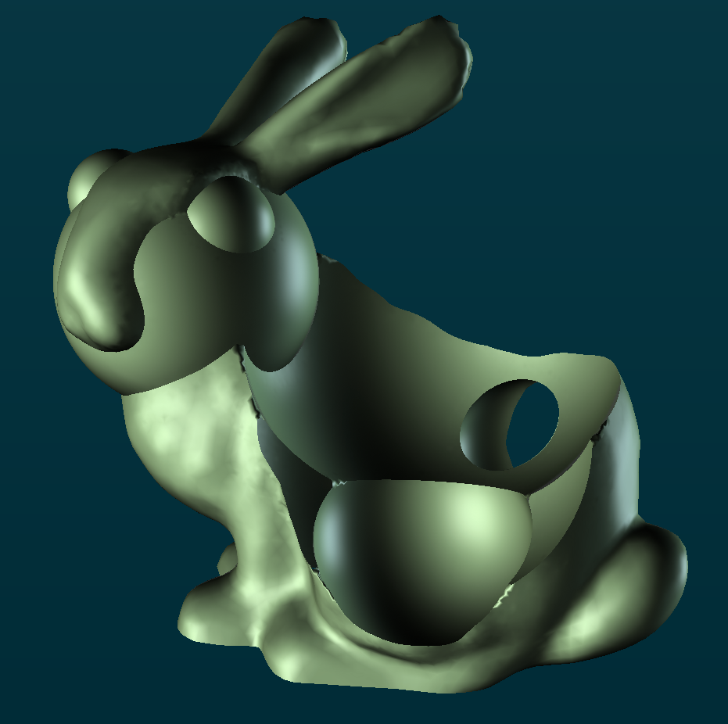
Examples

Slide 53
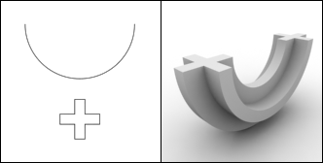
4- NURBS
Non-Uniform Rational B-spline. In NURBS modelling, lines and surfaces are not manipulated by moving vertices, edges, faces or polygons. Instead NURBS surfaces and lines are manipulated by special control points.
Note: the plus shape is drawn along the curve path

Slide 54
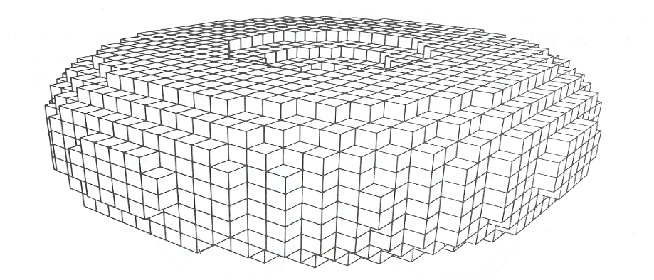

5-Voxel
This technique is to Partition space into uniform grid Grid cells are called voxels (like pixels).
This is a simple technique however it has a problem of storage for voxels of side length of n . Which can be O(n³) storage for NxNxN grid, (for example when n=1000, 1 billion voxels for 1000x1000x1000 )

Slide 55


Examples (by magicaVoxel tool https://ephtracy.github.io/ )

Slide 56
thanks

